Slide 1
Module Name: CSS3

Slide 2
CSS3
OBJECTIVES
1
T
To equip students with the basic understanding of CSS3 and its features
2
Students will learn about different advanced selectors & color models introduced with CSS3
3
To make students able to implement different transformations and animations on different elements

Slide 3

CSS3
OUTCOMES
At the end of this module, students are expected to learn
Features added to CSS3 & its applications
Create a page with CSS3 & add advanced selectors on different HTML elements
Understand & apply transformation, perspective & animations

Slide 4


CSS3
Document/Video Links
Topics | URL
Learning CSS3 | https://www.w3.org/Style/CSS/learning.en.html
Learn to style HTML using CSS | https://developer.mozilla.org/en-US/docs/Learn/CSS
CSS Tutorial – W3Schools | http://www.fadelk.com/files/Resources/153/005CSS.pdf
CSS3 Tutorials | https://www.youtube.com/watch?v=CUxH_rWSI1k https://www.youtube.com/watch?v=I_5or1sh8O0

Slide 5

Content
Introduction
Advanced Selectors
Dynamic Selector
Box Model
Color Model
Transformation
Perspective
Animation
Flexbox

Slide 6
Introduction
CSS3 is the newer version of CSS used for styling the web pages more effectively
CSS3 is divided into modules which makes styling of web pages more simpler and easier
It helps in creating dynamic web pages without using JavaScript
It also helps in creating responsive web pages

Slide 7
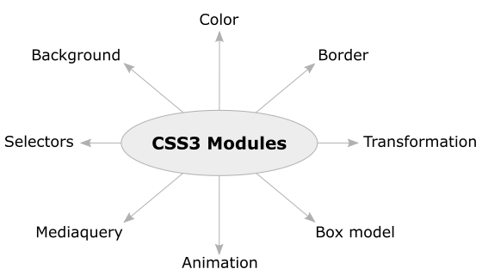
Introduction
Different CSS3 Properties

Slide 8
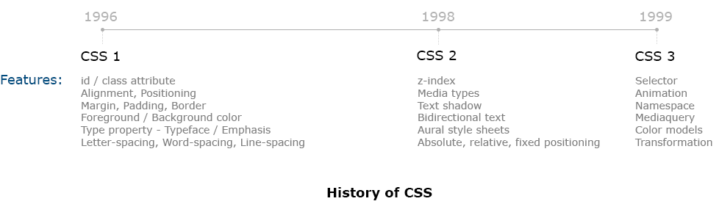
Introduction
History

Slide 9
Advanced Selectors
Selector is used to target and style an HTML element
In CSS3 new selectors have been introduced for efficient selection of HTML element
These selectors has been categorized into the following
Relational Selectors
Attribute Selectors

Slide 10
Advanced Selectors
Universal Selector
The universal selector, written as * (asterisk) matches every single element on the page
It may be omitted if other conditions exist on the target element
It is often used to remove the default margins and paddings from the elements for quick testing purpose
E.g.
{
margin: 0px;
}

Slide 11
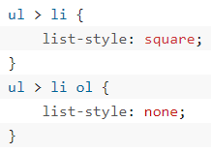
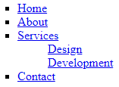
Advanced Selectors
Child Selectors
Used to select those elements that are the direct children of some element
A child selector is made up of two or more selectors separated by the greater than symbol (i.e. >)
These selectors can be used to select the first level of list elements inside a nested list that has more than one level

Slide 12
Advanced Selectors
Adjacent Sibling Selectors
The adjacent sibling selectors can be used to select sibling elements
This selector has the syntax like: E1 + E2, where E2 is the target of the selector
E.g.
Let us consider two sibling selectors <h1> & <p>, where bother <h1> & <p> share the same parent in the document structure
Along with that <h1> immediately precedes the <p> element such that only those paragraphs that comes immediately after each <h1> heading will have the associated style rules

Slide 13
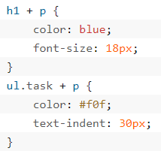
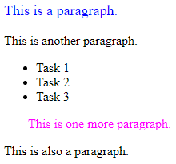
Advanced Selectors
Adjacent Sibling Selectors
E.g. contd…

Slide 14
Advanced Selectors
General Sibling Selectors
Similar to the adjacent sibling selector (E1 + E2), but it’s less strict
A general sibling selector is made up of two simple selectors separated by the tilde (∼) character
It can be written like: E1 ∼ E2, where E2 is the target of the selector
E.g.
Consider the selector h1 ~ p
It will select all the <p> elements that are preceded by the <h1> element, provided that both the elements share the same parent in the document structure

Slide 15
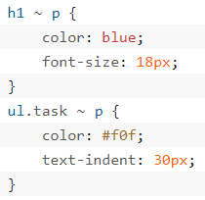
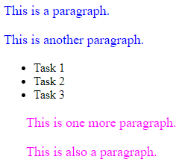
Advanced Selectors
General Sibling Selectors
E.g. contd…

Slide 16
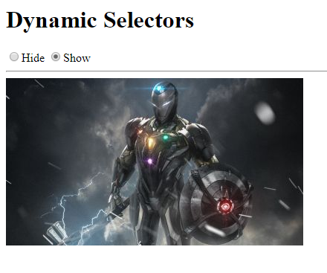
Dynamic Selector
Show/Hide based on radio button click
Using advanced selectors design a web page that contains two radio buttons namely show & hide such that as we click on either of them, it should show/hide the image

Slide 17
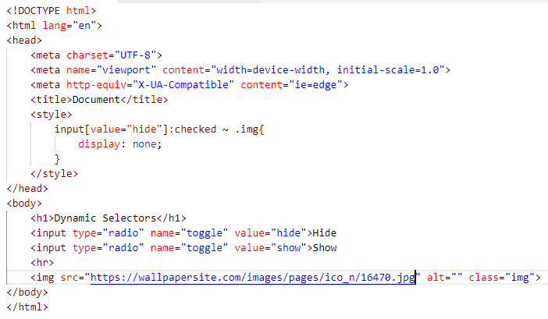
Dynamic Selector
Show/Hide based on radio button click
Code
Using sibling selector

Slide 18
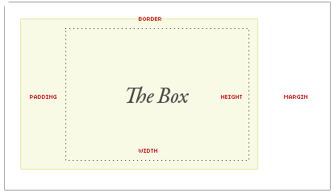
Box Model
CSS box model is a container which contains multiple properties including borders, margin, padding and the content itself
It is used to create the design and layout of web pages
CSS Box model has multiple properties such as
Borders
Margins
Padding
Content

Slide 19
Box Model
Since the beginning of CSS, the box model has worked like this by default
Width + padding + border = actual visible width of an element’s box
Height + padding + border = actual visible height of an element’s box
With Box Sizing
Width/height + padding + border = actual width or height (not affected by padding or border)

Slide 20
Box Model
Box Sizing
As the responsive design has become more prominent among the developers, there is need for an update to the old style box model
In CSS box model, the width & height of an element is applied to the element’s content box only
If the element has any border or padding, this is then added to the width and height to arrive at the size of the box that's rendered on the screen
The box-sizing property can make building CSS layouts easier and a lot more intuitive where an element's specified width and height aren't affected by padding or borders

Slide 21
Box Model
Box Sizing
The box-sizing property has the following possible values
Border-box: sets any border and padding in the values you specify for an element's width and height
If you set an element's width to 100 pixels, that 100 pixels will include any border or padding you added, and the content box will shrink to absorb that extra width
Syntax
* {
box-sizing: border-box;
}

Slide 22
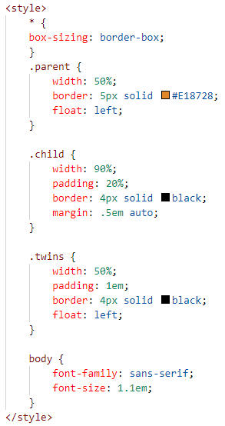
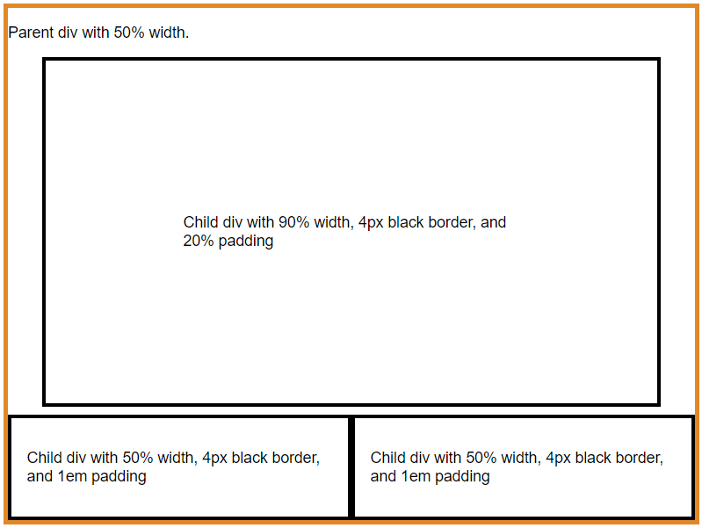
Box Model
Border-Sizing
E.g.

Slide 23
Color Models
Color models have been introduced using which we can display color with opacity
Opacity property is used to change the opacity or transparency level of your HTML elements
Using opacity property the opacity of the entire element changes
Syntax
div{
background-color: red;
opacity: 0.5;
}
Opacity value ranges between 0 & 1. 0 being fully transparent and 1 being fully opaque
The default value of opacity is 1

Slide 24
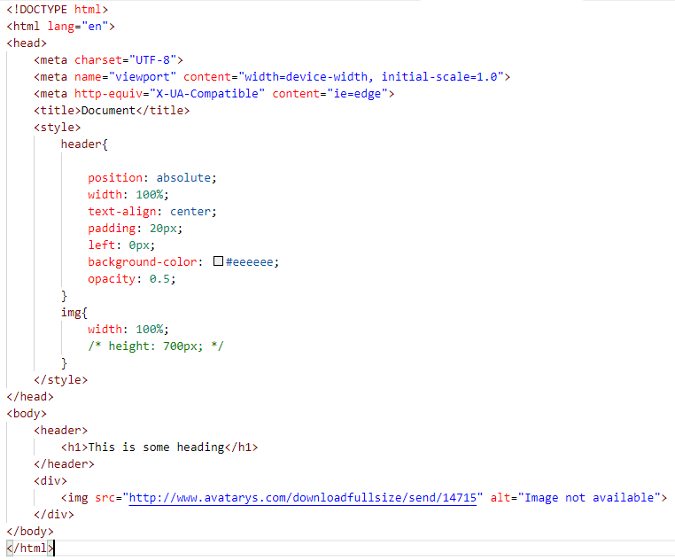
Color Models
E.g.

Slide 25
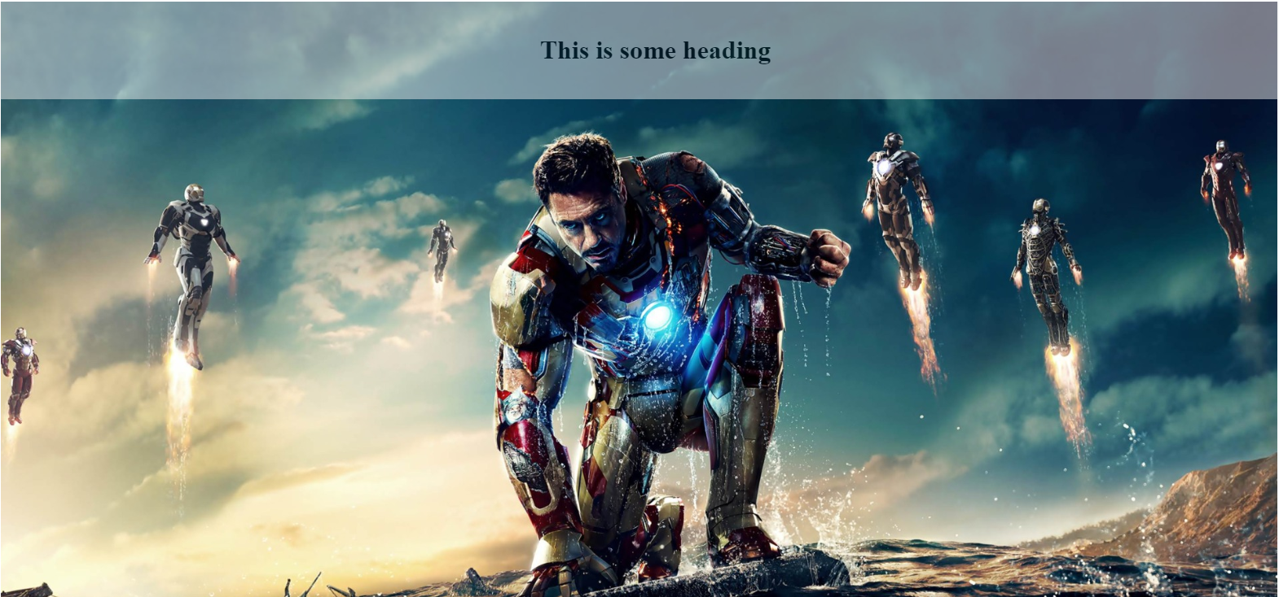
Color Models
Header opacity is 50%
Output

Slide 26
Color Models
RGBA Color Values
Colors can be defined in the RGBA model (red-green-blue-alpha) using the rgba() functional notation
RGBA color model are an extension of RGB color model with an alpha channel — which specifies the opacity of a color
The alpha parameter accepts a value from 0.0 (fully transparent) to 1.0 (fully opaque)

Slide 27
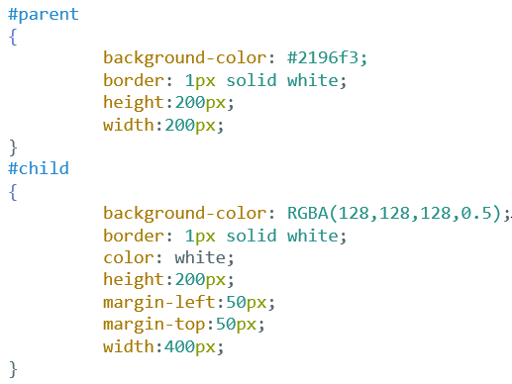
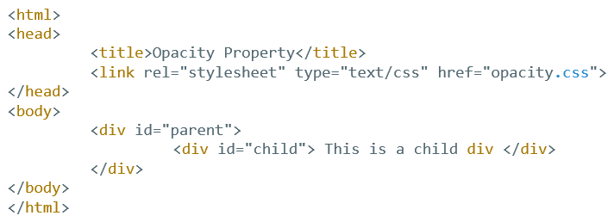
Color Models
E.g.
Opacity of 0.5 is applied to child element

Slide 28
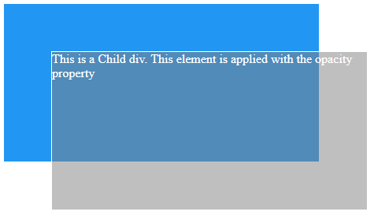
Color Models
Output
Here the opacity is applied to the background-color alone, not to the text color

Slide 29
Transformation
The transform css property lets us rotate, scale, skew or translate an element
It modifies the coordinate space of the css formatting model
We manipulate an elements appearance using transform functions

Slide 30
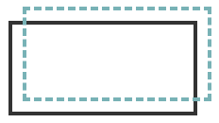
Transformation
translate()
The translate(x,y) function is similar to relative positioning, translating, or relocating an element by x from the left and y from the top
translatex() & translatey() are the subsidiary functions for specifying only left/right values
transform: translate(15px, -15px)

Slide 31
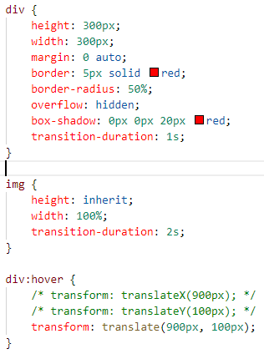

Transformation
E.g.

Slide 32
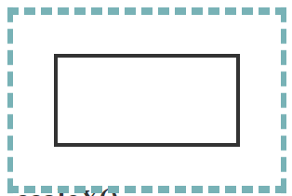
Transformation
scale()
The scale(w,h) property scales an element by ‘w’ width & ‘h’ height
In case if only one value is declared, the scaling will be proportional
transform: scale(1.5, 2)

Slide 33
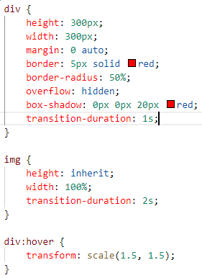
Transformation
E.g.

Slide 34
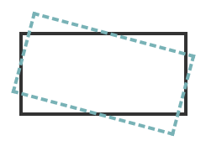
Transformation
rotate()
The rotate(angle) function will rotate an element about the point of origin but the angle value specified
transform: rotate(15deg)

Slide 35
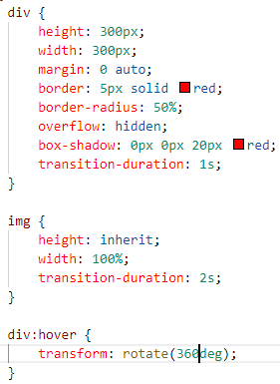
Transformation
E.g.

Slide 36
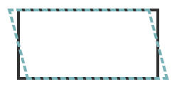
Transformation
skew()
The skew(x,y) function specifies a skew along the X and Y axes
The x specifies the skew on the x-axis, & y specifies the skew on the y-axis
If there is only one parameter, then its the same as skew(x,0) or skewX(x)
transform: skewx(15deg)

Slide 37
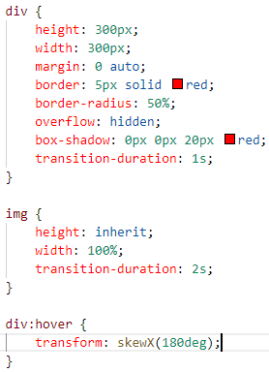
Transformation
E.g.

Slide 38
Perspective
The perspective CSS property gives an element a 3D-space by affecting the distance between the Z plane and the user
It defines how far the object is away from the user
Hence, a lower value will result in a more intensive 3D effect than a higher value
When defining the perspective property for an element, it is the CHILD elements that get the perspective view, NOT the element itself

Slide 39
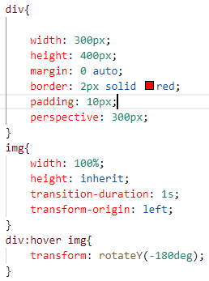
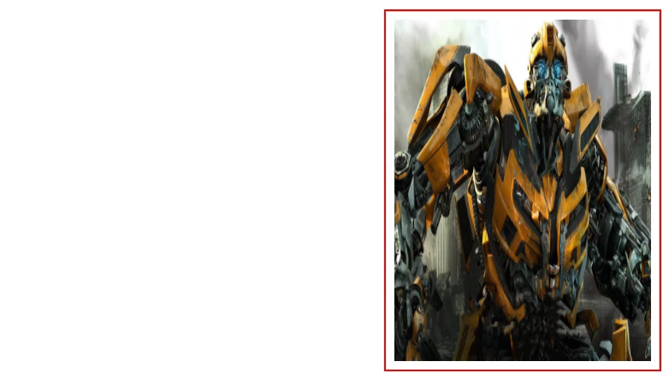
Perspective
E.g.

Slide 40
Animation
CSS3 introduces animations that makes it possible to animate transitions from one CSS style configuration to another
Animations consist of two components, a style describing the CSS animation and a set of ‘keyframes’ that indicate the start and end states of the animation’s style, as well as possible intermediate waypoints
To create a CSS animation sequence, you style the element you want to animate with the animation property or its sub-properties

Slide 41
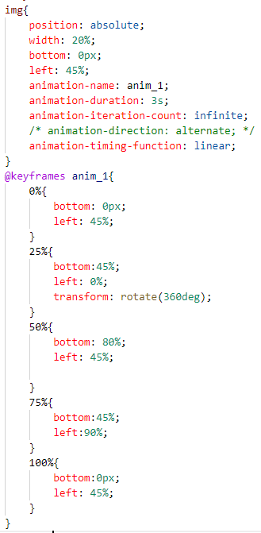
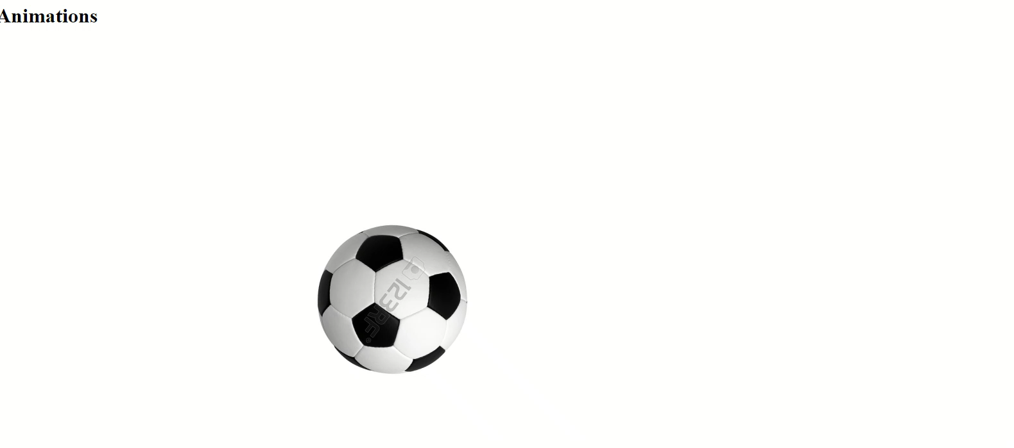
Animation
E.g.

Slide 42
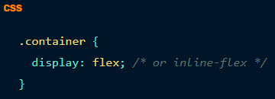
Flexbox
The Flexbox (Flexible Box) layout module aims at providing a more efficient way to lay out, align and distribute space among items in a container (even if their size is unknown or dynamic)
It gives container the ability to alter its items’ width/height (& order) to best fill the available space
A flex container expands items to fill available free space, or shrinks them to prevent overflow
Syntax:

Slide 43
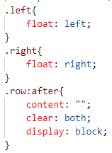
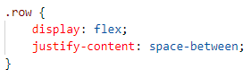
Flexbox
Prior to flexbox
After using flexbox

Slide 44
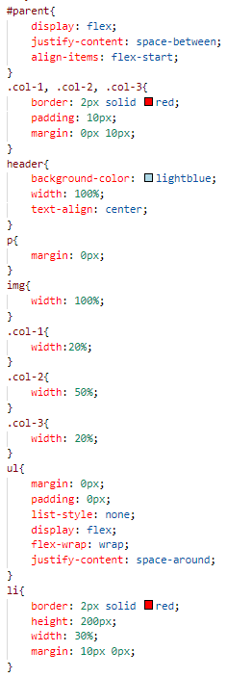
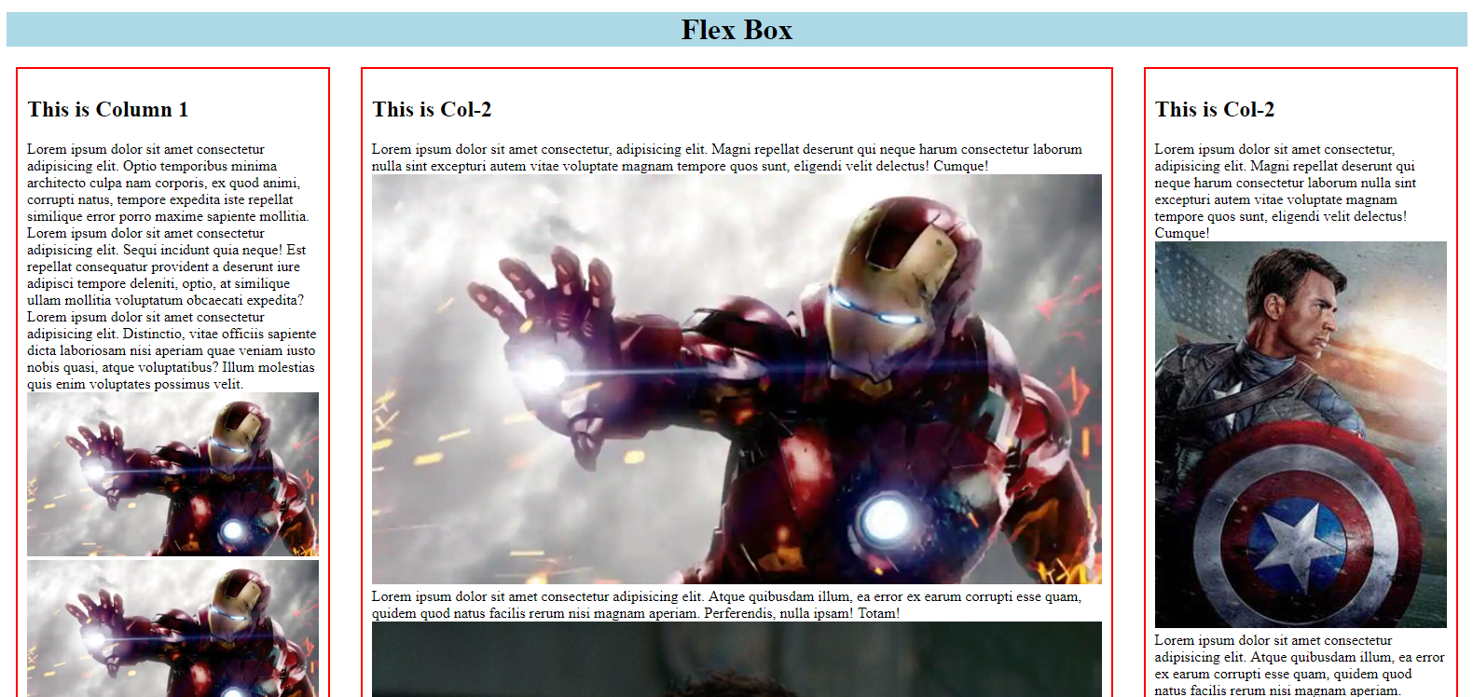
Flexbox
E.g.

Slide 45
Thank You

